Slide 1


u
NEXA TECH PVT.LTD
Future Tech Company
o

Slide 2
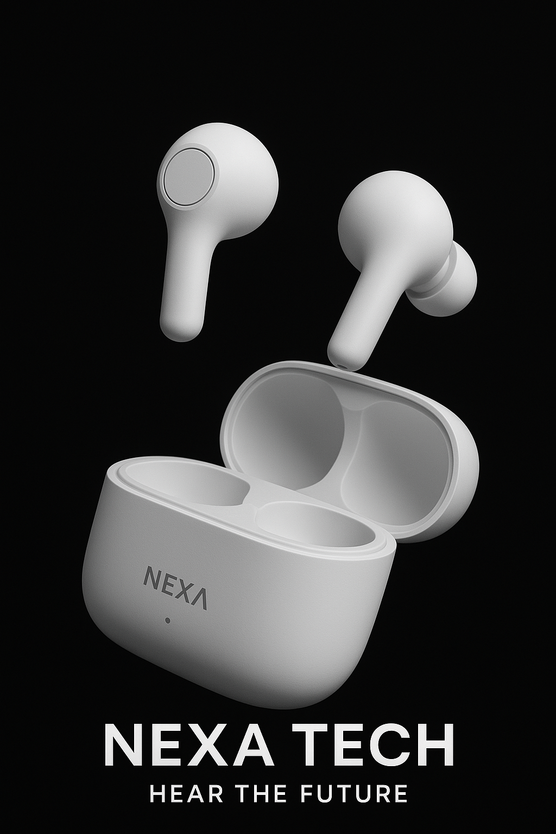
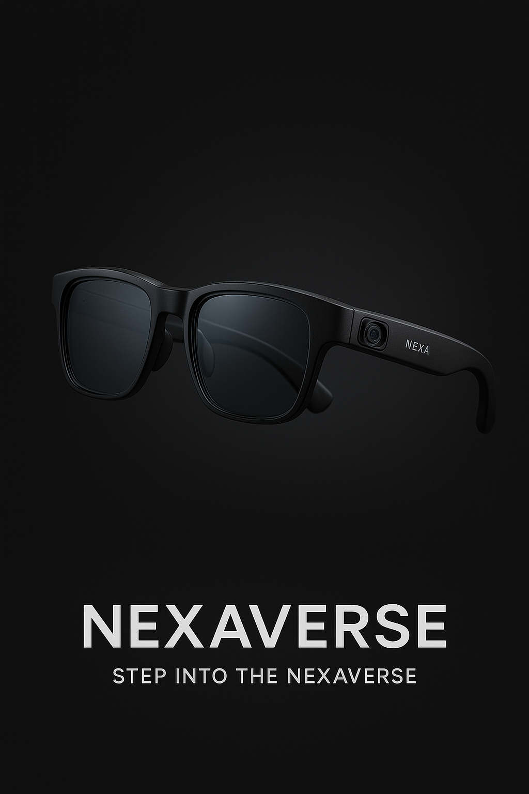
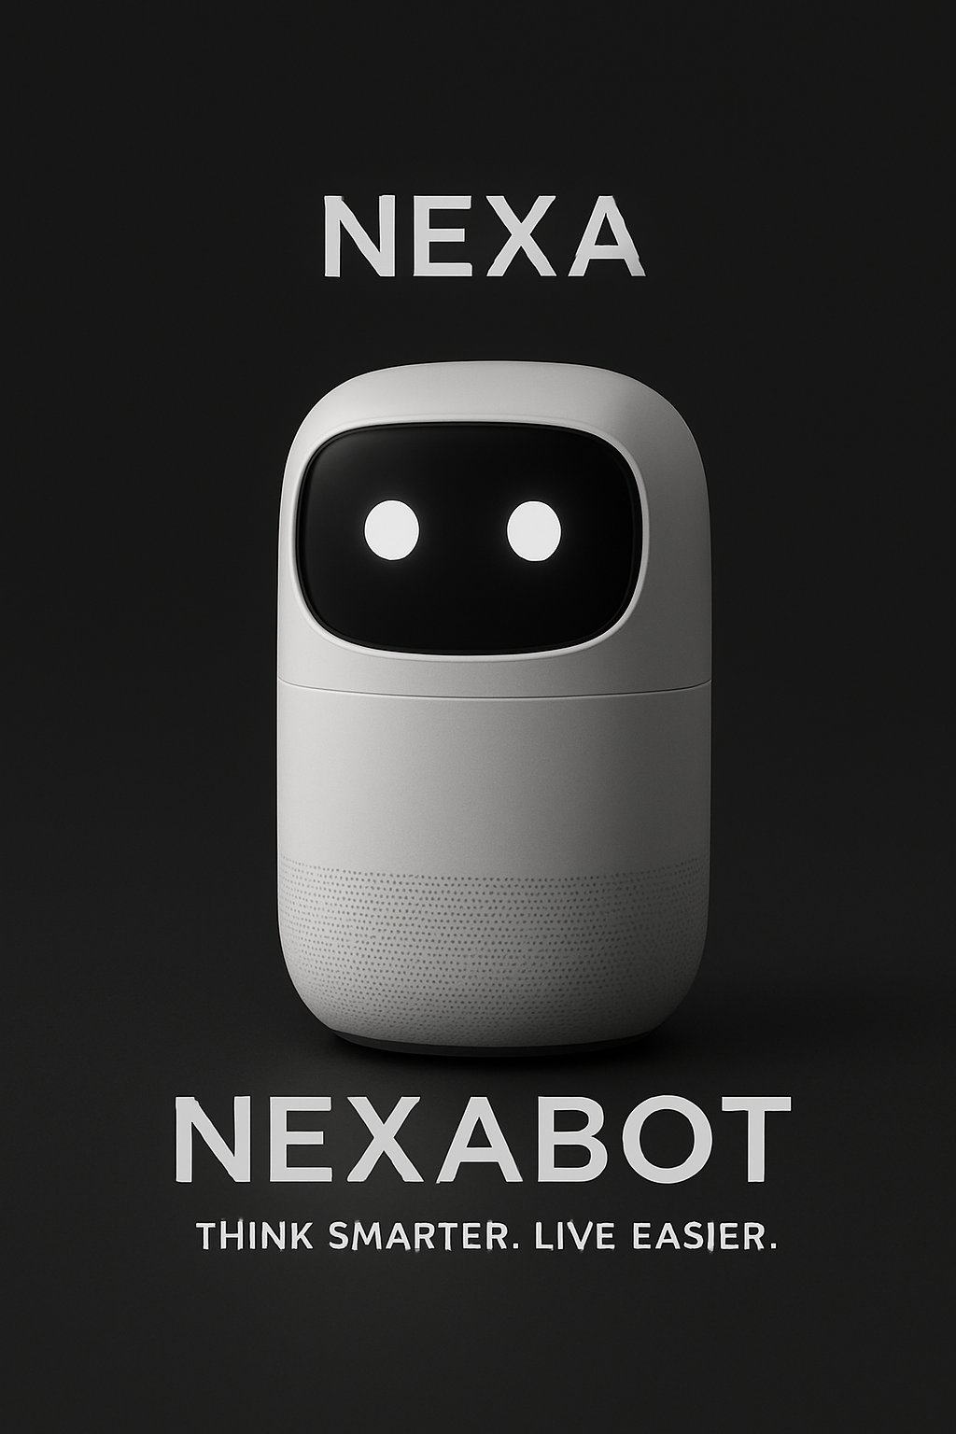
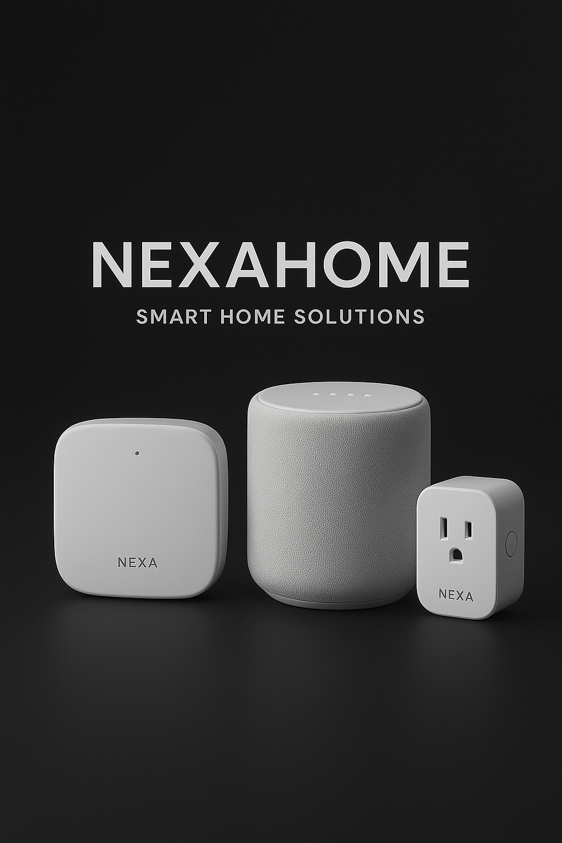
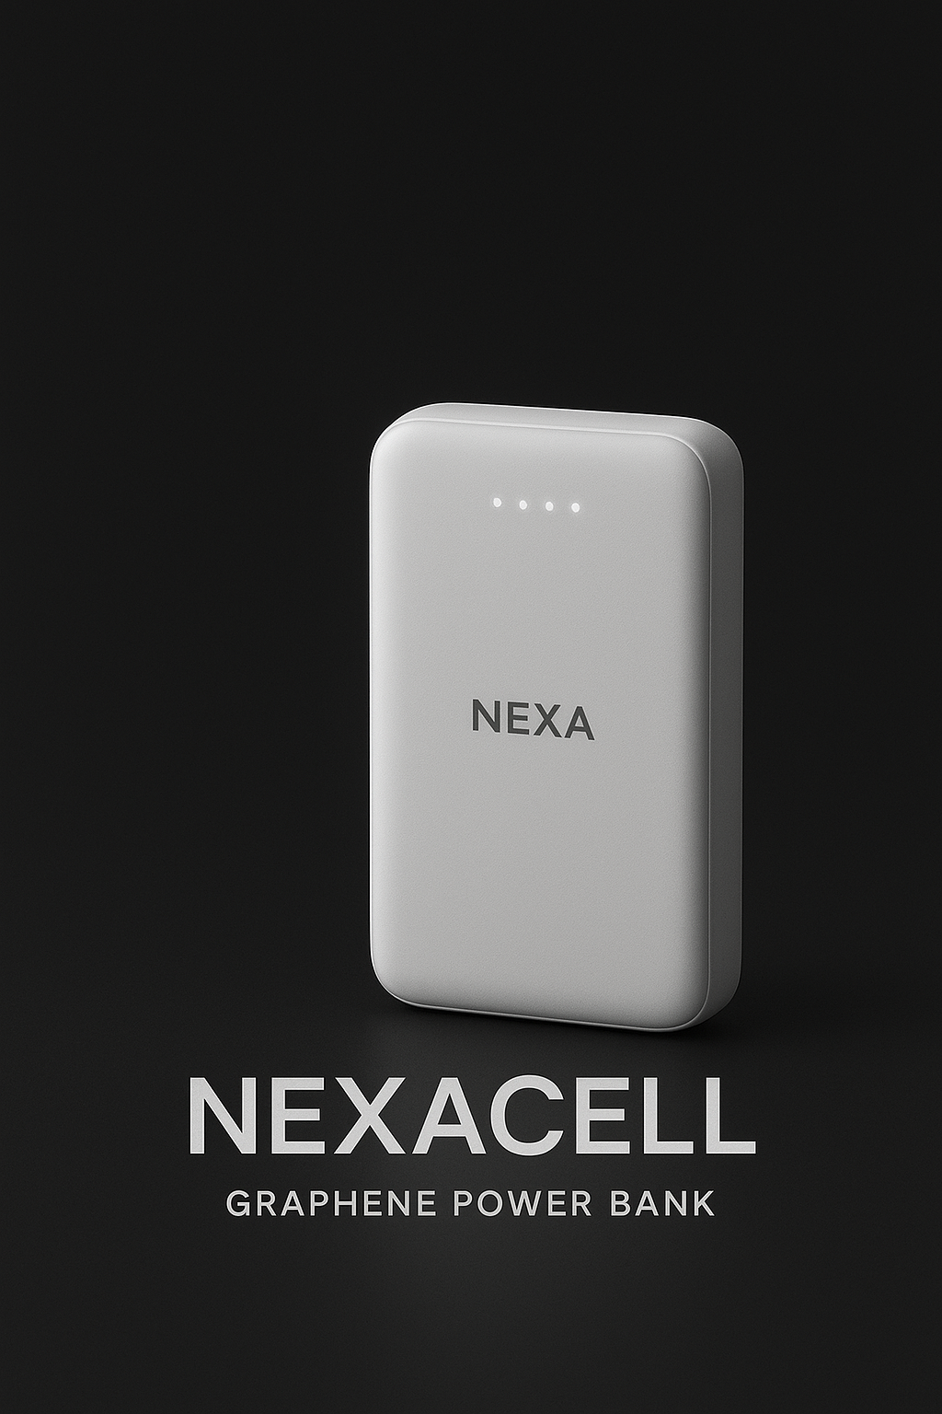
u
NexaPods
NexaVerse
Our Products
NexaBOT
NexaPods
NexaVerse
NexaHome
NexaCell
NexaBOT
NexaHome
NexaCell
o

Slide 3

u
⚙️ 1. NexaSync™ – Universal AI Ecosystem
All Nexa devices (Earbuds, NexaBot, NexaHome, NexaCell, NexaVerse) sync through one AI core. ➡️ The system learns your habits, predicts needs, and auto-optimizes power, sound, light, and environment
🧠 2. NexaMind™ – Adaptive Intelligence Engine
A self-learning neural engine that improves over time using on-device machine learning. ➡️ It personalizes performance, sound quality, even emotional tone recognition in voice interactions.
⚡ 3. QuantumCharge™ – Graphene Energy Flow
Next-gen graphene batteries recharge from 0–100% in under 10 minutes with thermal balancing. ➡️ Power banks, earbuds, and glasses all share charge wirelessly.
👁️ 4. NexaSense™ – Real-Time Environmental Awareness
Advanced sensors analyze your environment — light, sound, air quality, and even emotional tone of speech. ➡️ The system auto-adjusts lighting, mood music, or recommends breaks.
🗣️ 5. NexaVoice™ – Emotion-Aware Assistant
Unlike Alexa or Siri, NexaVoice detects your mood from your tone. ➡️ If you sound stressed, it switches to calm responses and adjusts lighting or music automatically.
o

Slide 4
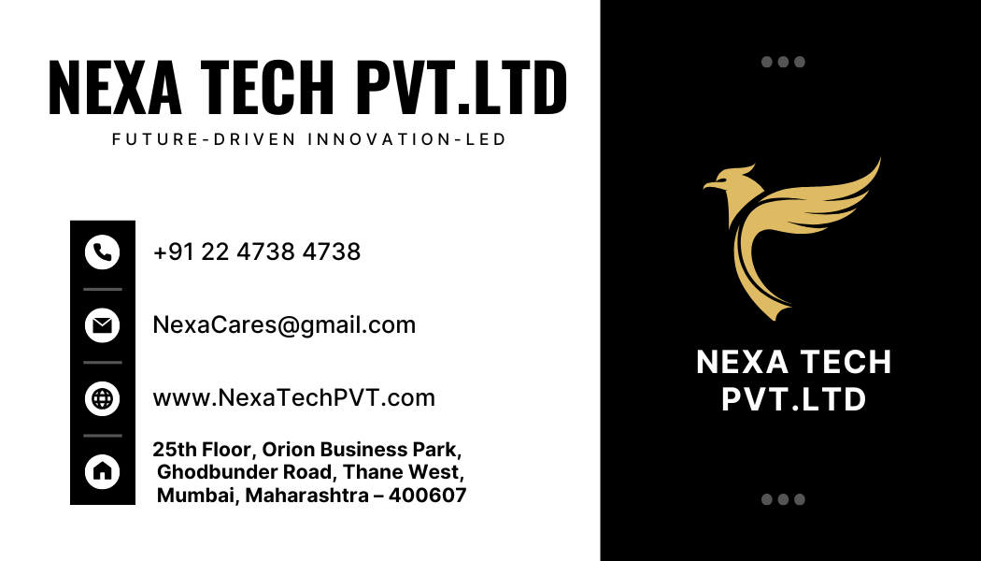

u
🔒 7. NexaShield™
🪩 8. HoloLink™
🧬 9. NexaAdapt™
🚀 10. NexaCloud 2.0
Be part of the future. Be part of intelligence. Be part of NEXA.
We Innovate | Elevate | Dominate
o

Slide 5
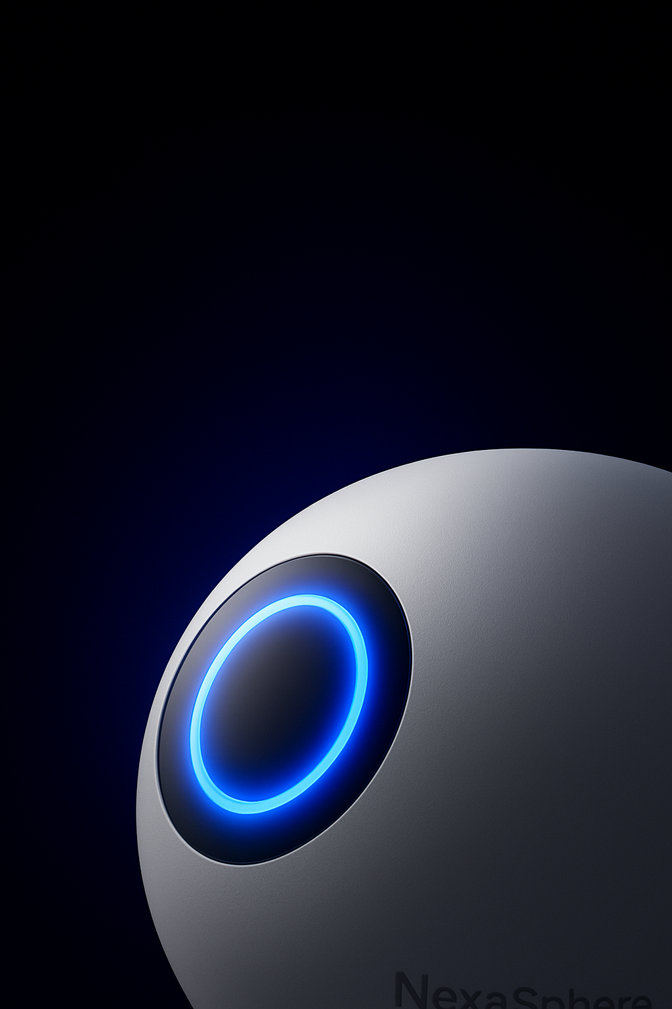
u
Launching Soon
ThankYOU
Regards, Nexa TECH PVT.LTD
o

